Slide 1


CaféNova Excel Data Analysis Project
Final Excel Project
Presented: By Geoffrey McOwens Muonja

Slide 2

Data Cleaning
Fill blanks in dataset
Fix incorrect or missing dates
Check and correct numerical values

Slide 3
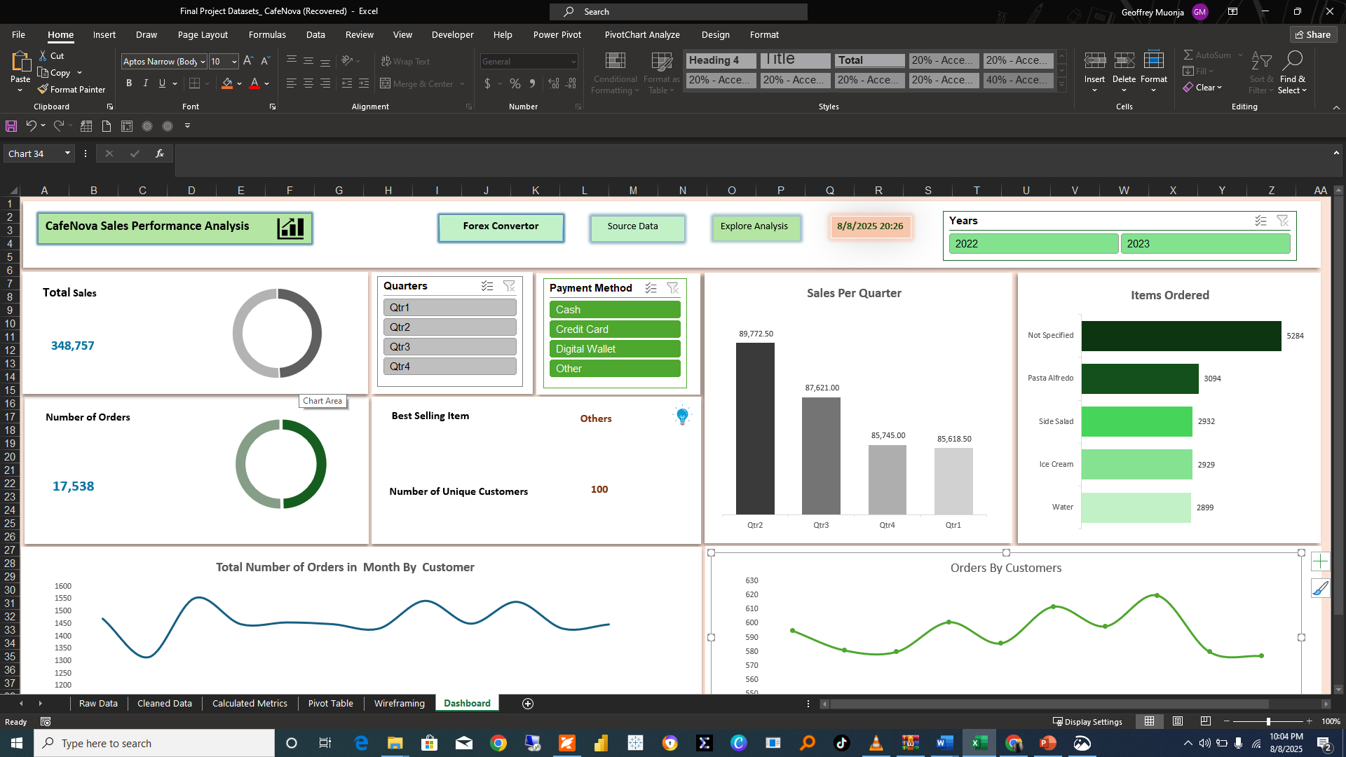

Slide 4

Data Exploration
Find sales patterns
Identify top-selling items
Analyze performance by category
Use pivot tables, filters, and summary stats

Slide 5

Recomendations
Optimize Product and Menu Strategy
Action: Analyze the profit margins of all products, especially the "Best Selling Item.
Reasoning: High sales volume doesn't always equal high profitability. The company needs to identify which items are most profitable and which are merely popular.
Recommendation: Promote High-Profit Items: Actively market and upsell products with the highest profit margins. Bundle Products: Create meal deals or bundles that pair a high-demand, low-margin item with a less popular but high-margin item to increase overall basket value.
Review Underperforming Items: Consider adjusting the price, improving the recipe, or removing items from the menu that have low sales and low-profit margins.
2. Enhance Customer Loyalty and Retention
Action: Segment the customer base to identify "power users" or repeat customers.
* Reasoning: Retaining an existing customer is often more cost-effective than acquiring a new one. The "Orders by Customers" chart suggests that a core group of customers drives the business.
Recommendation:
Launch a Loyalty Program: Offer rewards, discounts, or exclusive perks to repeat customers.
Targeted Marketing: Send personalized offers or new product announcements to the most frequent customers based on their past purchase history.
Gather Feedback: Proactively solicit feedback from top customers to understand what they like and how the company can improve.

